Slide 1

MEDI Buzz

Slide 2



Problem Statement
How might we simplify daily medication management for elderly patients and their caregivers

Slide 3

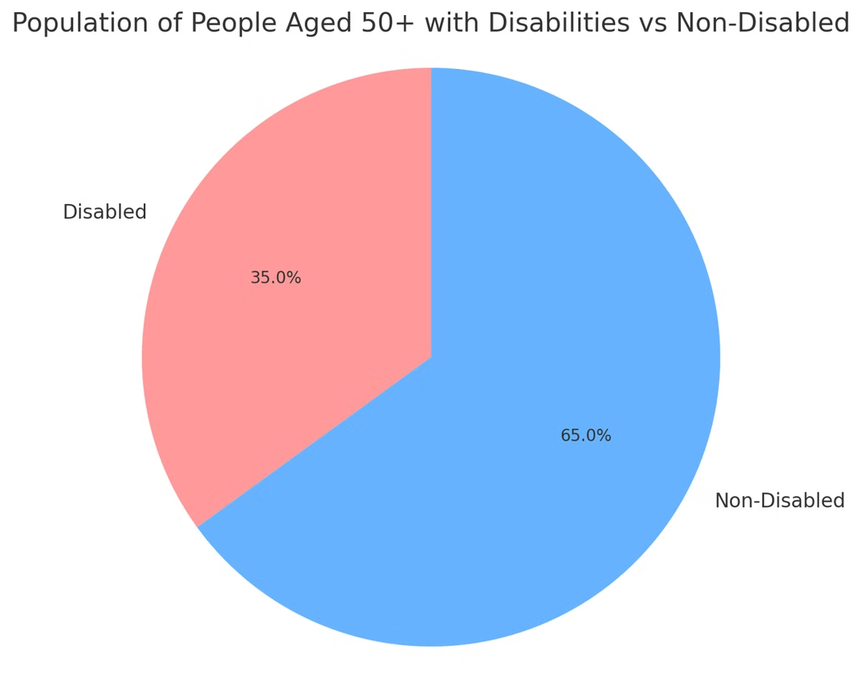
Target Audience
Elderly patients (typically age 50+) who:
Take multiple medications daily may experience memory issues, low tech-literacy, or physical limitations (e.g., arthritis, impaired vision)
Live alone or with minimal caregiver support want to maintain independence while managing their health

Slide 4
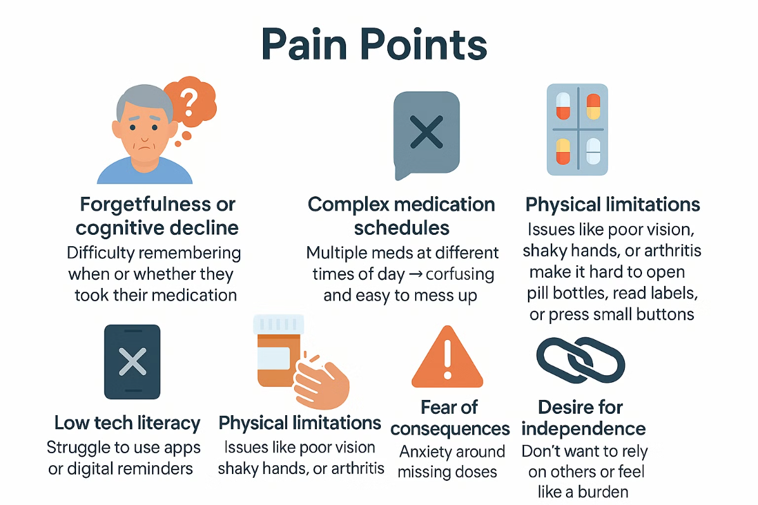

Slide 5
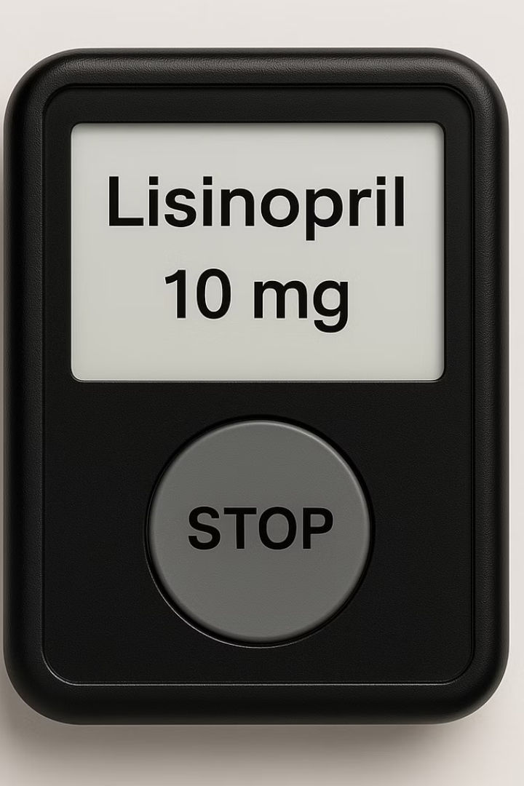
Solution Overview
Our system utilizes a buzzer for timely medication notifications. It integrates with middleware to load prescription data. Users get reminders on the buzzer, with mobile/email alerts as a backup

Slide 6
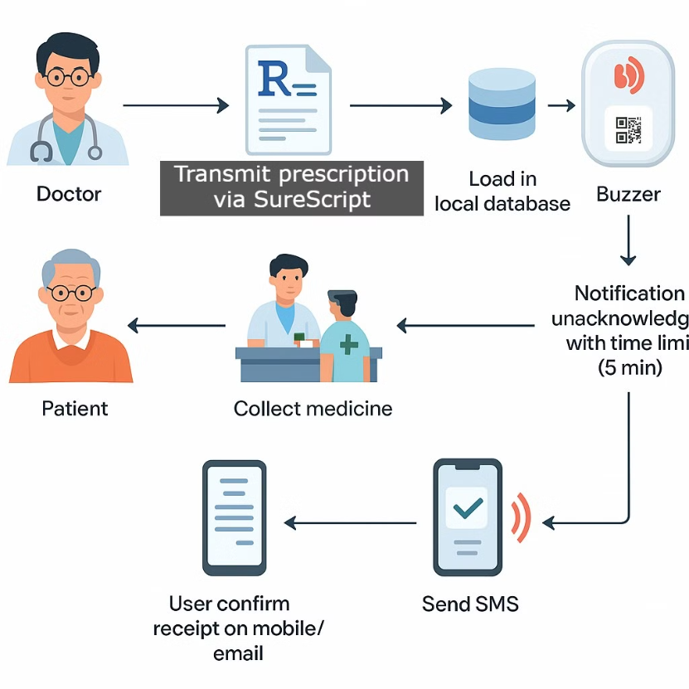

Slide 7
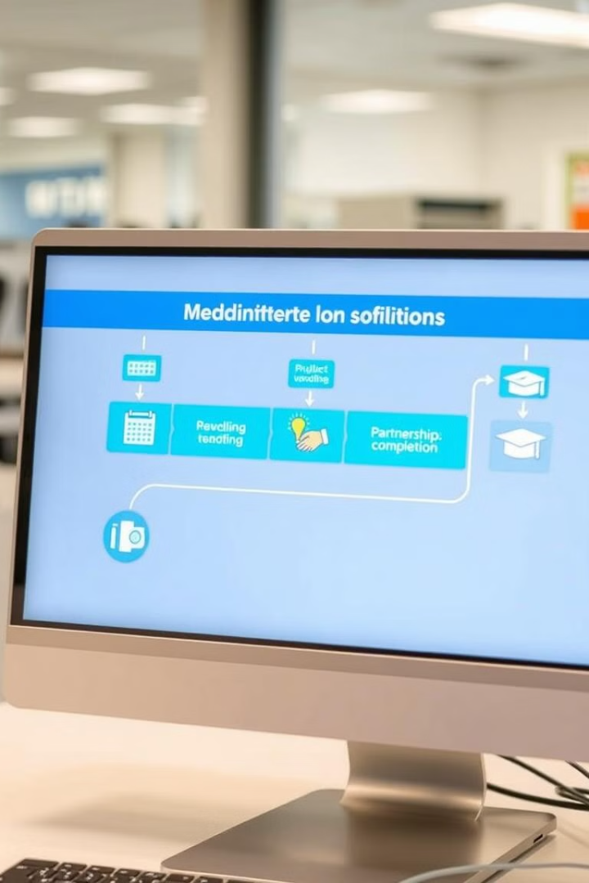
Next Steps
Collaborate with middleware & pharmacies
Develop and test buzzer hardware
Build a mobile application, to modify the buzzer as needed

Slide 8
Thank You
Shoot your questions…

